Slide 1
Ch15 Software development

Slide 2
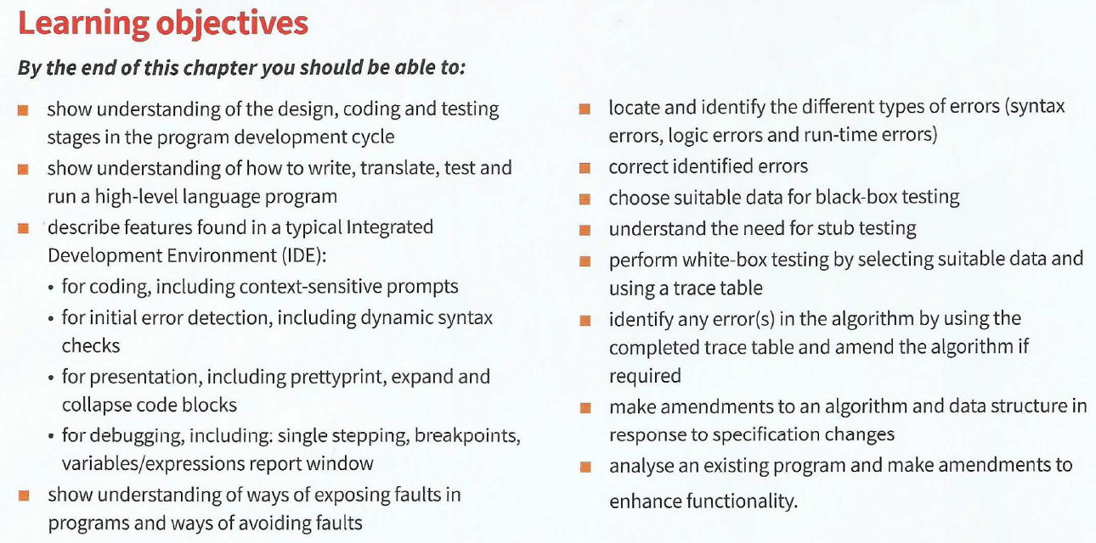

Slide 3
1. Stages in the program development cycle
Problem solving
Problem definition
usually done in structured English
Known as a ‘specification‘
planning a solution
decide how to solve the problem (more than one solution)
bottom-up: start with a small sub-problem and then build on this
top-down: stepwise refinement using pseudocode, flowcharts or structure charts.
http://codingfox.com/0-3-top-down-and-bottom-top-approach/

Slide 4
Design
identifier table -- data structures
1D array or a 2D array?
a file to store data long-term?
Plan your algorithm by drawing a flowchart or writing pseudocode

Slide 5

Coding
choose a suitable high-level programming language
weigh up the pros and cons of each one.
implement your algorithm by converting your pseudocode into program code
Depending on your editor you may have some helpful facilities
syntax errors may be flagged up by your editor
A syntax error is a 'grammatical' error, in which a program statement does not follow the rules of the high-level language constructs.

Slide 6
Translation
Some syntax errors may only become apparent when you a re using an interpreter or compiler to translate your program.
Interpreters and compilers work differently
When a program compiles successfully, you know there will be no syntax errors remaining. The compiler stops when it first notices a syntax error. The error is often on the previous line. The compiler can‘t tell until it gets to the next line of code and finds an unexpected keyword.
Only statements that are about to be executed will be syntax checked. So, if your program has not been thoroughly tested, it may even have syntax errors remaining.

Slide 7
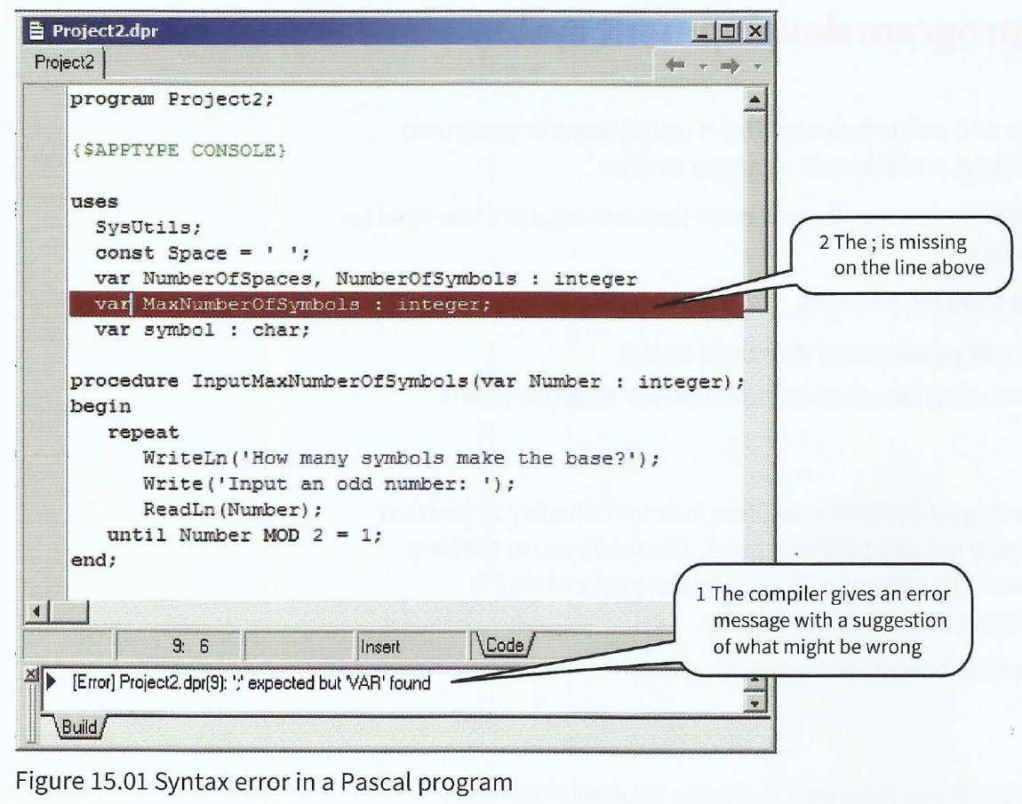

Slide 8
Execution
you may find it takes several attempts before the program compiles
When execute the program
it may 'crash', then → debug the code
It may run and give you some output, but does the program do what you want?

Slide 9
Testing
Only thorough testing can ensure the program really works under all circumstances
Implementation: coding, translation, testing
Documentation
Maintenance

Slide 10
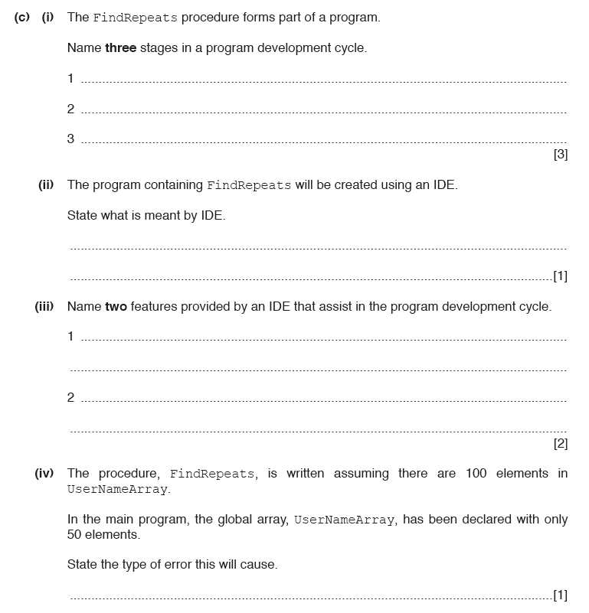
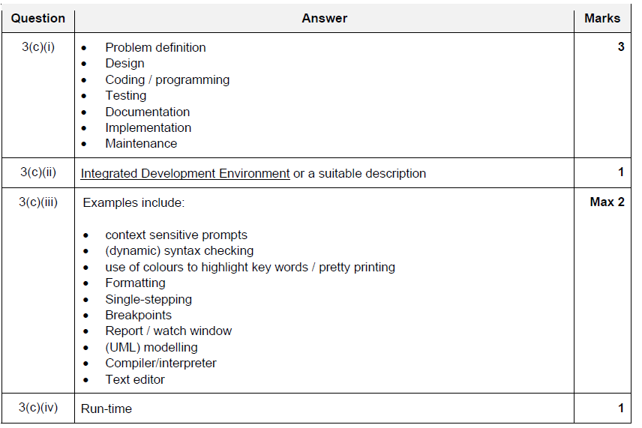

Slide 11
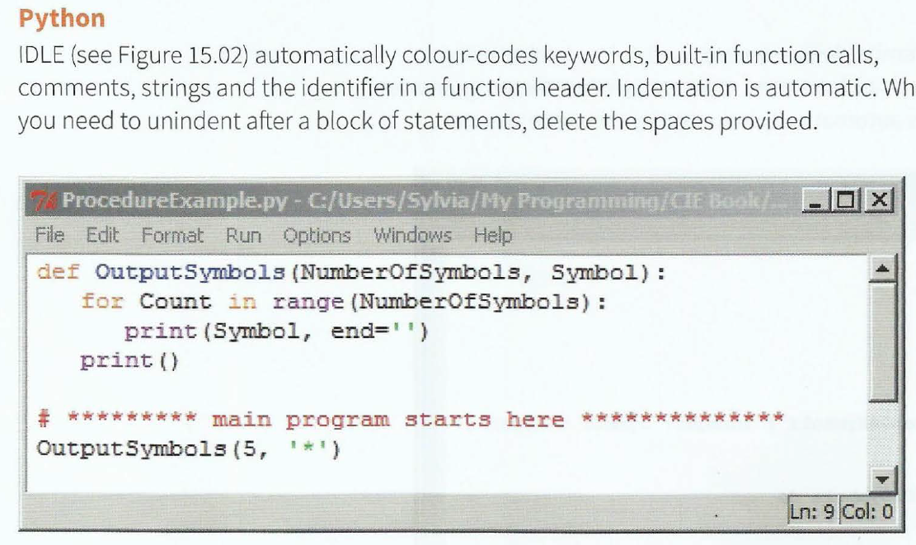
Features found in a typical Integrated Development Environment (IDE)
Pretty printing: refers to the presentation of the program code typed into an editor. It includes indentation, colour-coding of keywords and comments.

Slide 12
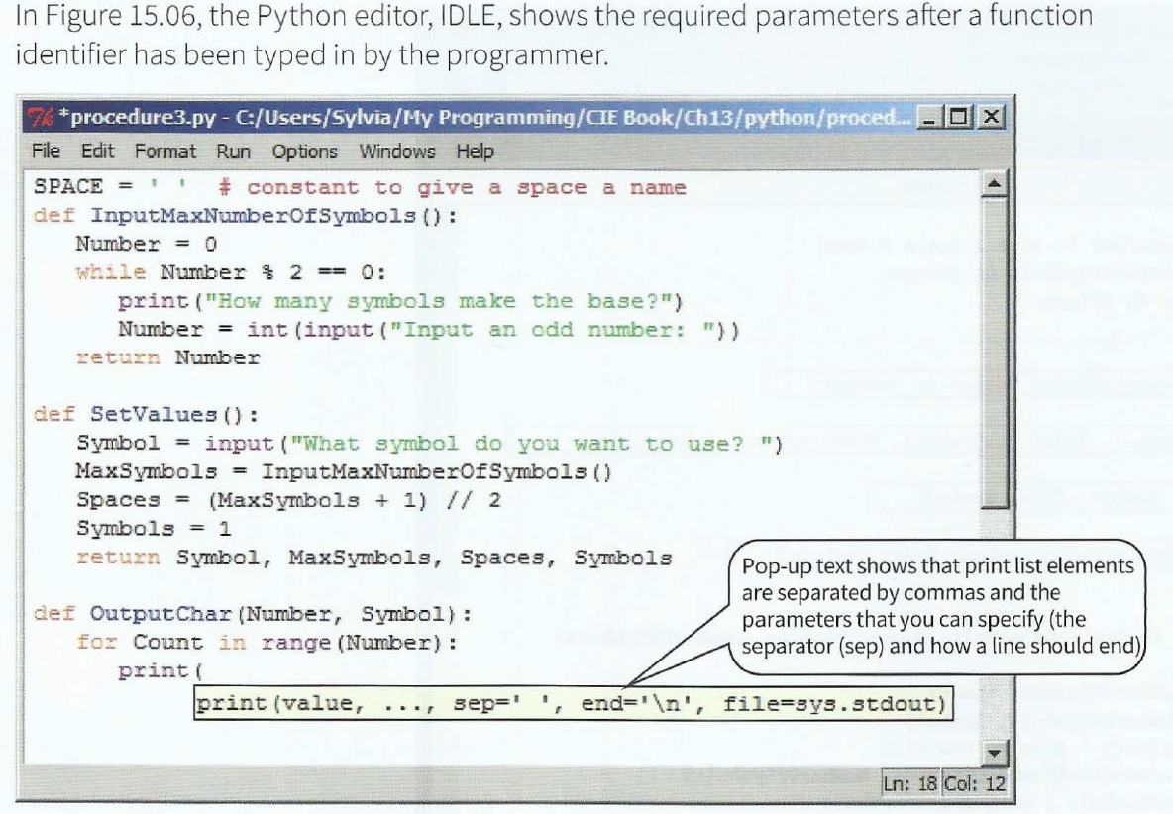
Context-sensitive prompts
This feature displays hints or a choice of keywords and available identifiers appropriate at the current insertion point of the program code.

Slide 13
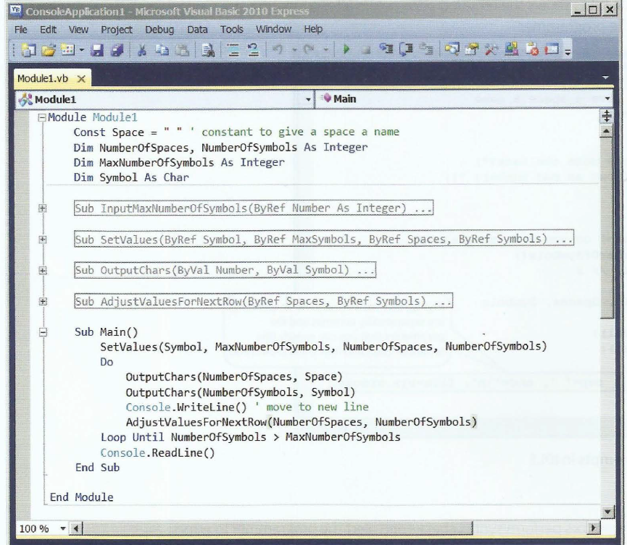
Expanding and collapsing code blocks
When working on program code consisting of many lines of code, it saves excessive scrolling if you can collapse blocks of statements.

Slide 16
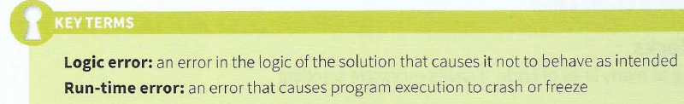
Testing strategies
syntax errors
logic errors
run-time errors

Slide 17
homework
Coding for pairing game
Worksheet – structure chart 2 questions
Worksheet – ch15
Remind: PA2 – projects
SA2 – Oct 29, all ch12-ch15
ddl – Monday 8:00

